Slide 1

Exploratory Data Analysis
G2M insight for Cab Investment firm
Jun 22, 2021

Slide 2

Agenda
Executive Summary
Problem Statement
Approach
EDA
EDA Summary
Recommendations

Slide 3
Background Introduction
XYZ is a private firm in US. Due to remarkable growth in the Cab Industry in last few years and multiple key players in the market, it is planning for an investment in Cab industry and as per their Go-to-Market(G2M) strategy they want to understand the market before taking final decision.
Objectives: Provide and present the recommendations and insights for the investment firms in order to choose one Cab firm with potential in the future.
Analysis Summary:
Data summary for descriptive information
Data visualization for insight
Hypothesis testing for verification
Conclusion

Slide 4
Preparation for Analysis
Combined three tables Cab_Data.csv, City.csv, Customer_ID.csv, Transaction_ID.csv into one data frame named df
Data frame information:
359392 entries
16 columns
dtypes: float64(3), int64(6), object(5)
Timeframe of the data: 2016-01-02 to 2018-12-31
Assumption:
Outlier for Transaction ID 10170615 is detected, but without further information including time duration, packages carrying, or any other service not included in data, we only treat it as a extreme instead of excluding this outlies in the analysis.
Profit are calculated by Price Charged minus Cost of Trip, and all other factors are supposed to be included in Price Charged and Cost of Trip.
We classify the definition between users and customers that users are the people having registered for the cab service, but the customers are the people having received the cab serive.

Slide 5
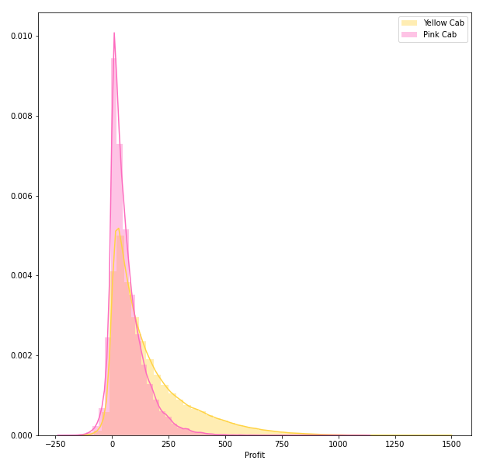
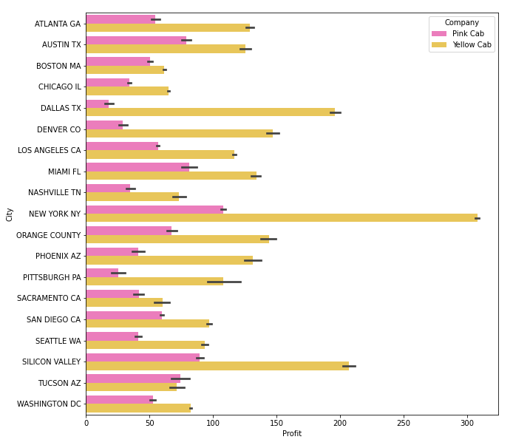
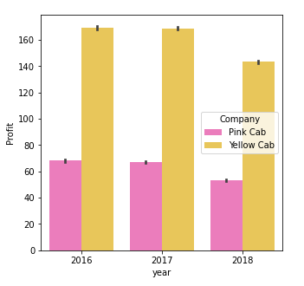
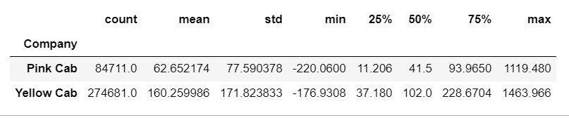
Profit Analysis
Based on the graph of profit distribution on the left, both two firms have similar distribution of profit per ride, but Pink Cab has more centralized at the range from 0 to 250 than Yellow Cab.
Based on the graph on the right, in the most of cities, Yellow Cab has higher profit than Pink Cab has; in particular, Yellow Cab has two times more profit than Pink Cab in New York City.
Annually, Yellow Cab is still more profitable than Pink Cab.

Slide 6
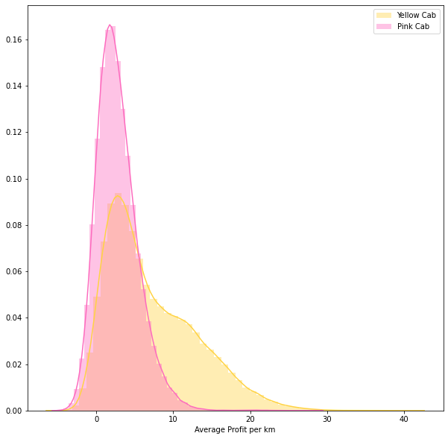
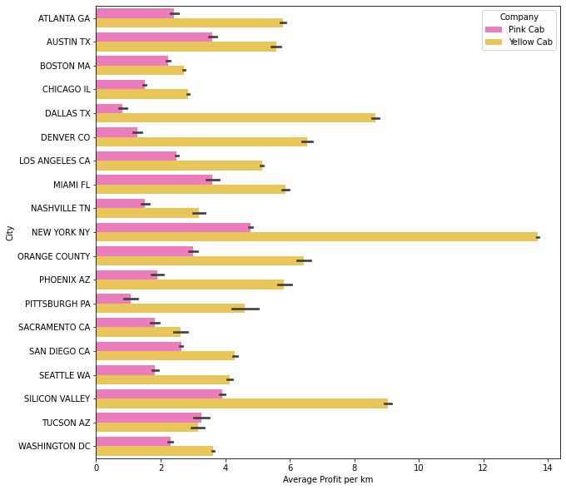
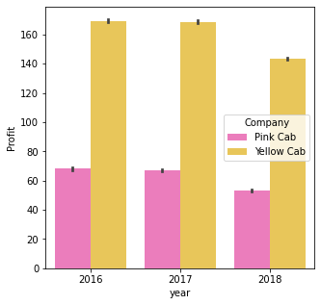
Profit Analysis
In the sense of average profit, it has the similar pattern to the profit pattern. The Yellow still have the profit advantage by the comparison with the Pink Cab.

Slide 7
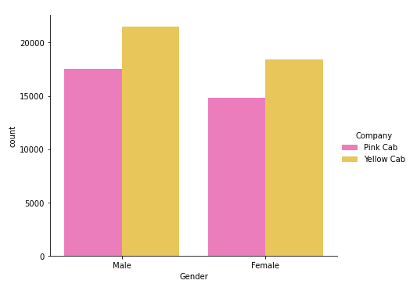
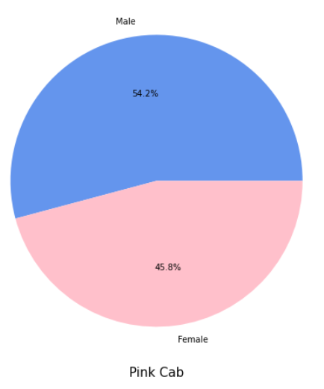
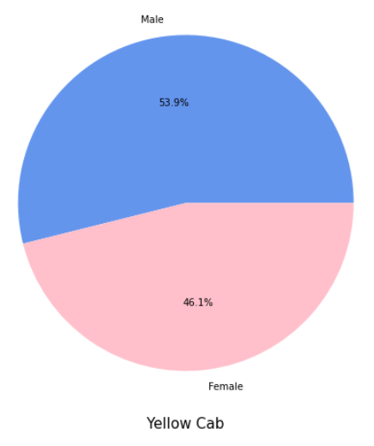
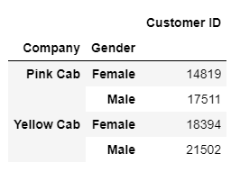
Customer Analysis
For the first insight, no matter whether is male or female customers, the number of customers from Yellow Cab is still more than that from Pink Cab.
Two firms have the similar ratio of male customers count to female customers count.

Slide 8
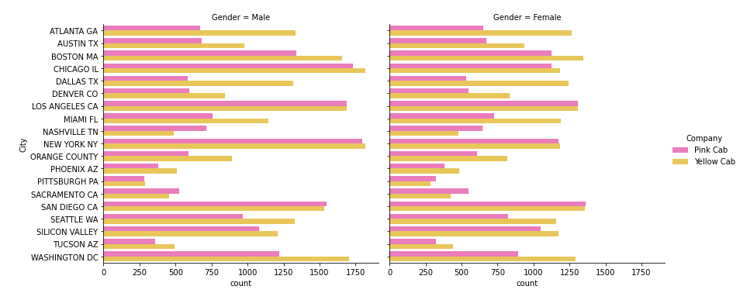
Customer Analysis
For the overview of customer count, in the most of cities, Yellow Cab has more customers than Pink Cab has. By classification of gender, there are obvious differences in the number of male customers while there exists comparatively small difference in the number of female customers between Yellow Cab and Pink Cab.

Slide 9
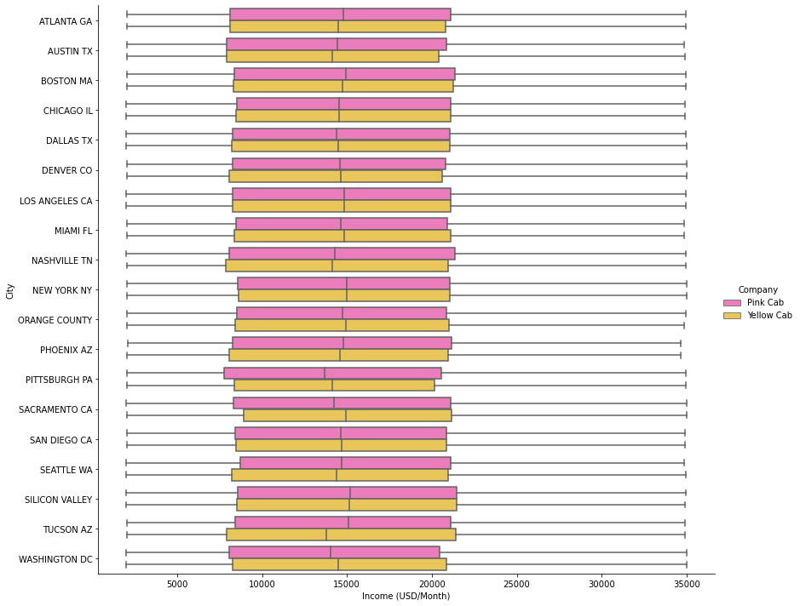
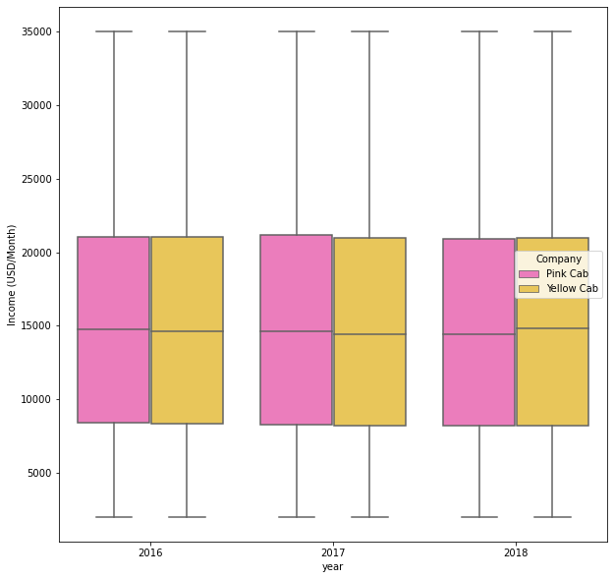
Customer Income Analysis
The income distributions of customers from two firms are similar in each city. In other word, in most of city, there doesn’t exist an obvious relation between customers’ income and their choice of cab service.
Also, in most of cities, the maximum and minimum of two customer income distributions stay at the same level. No matter whether you are high- or low-income people, it seems not to affect customers choice for the cab service.
Same logic applied to the annual customer income distributions, two firms have almost the same customer income distributions.

Slide 10
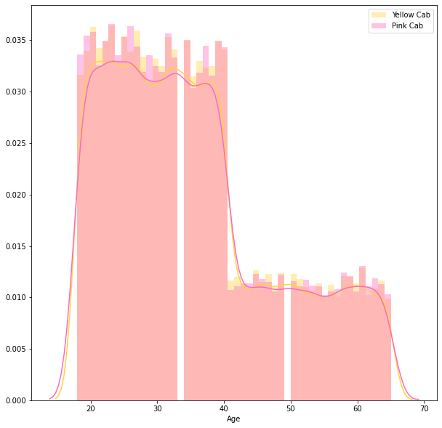
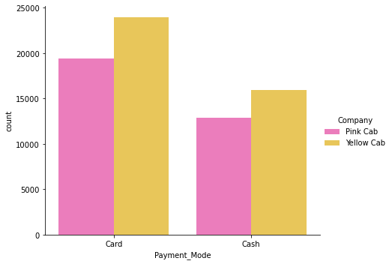
Customer Analysis

Slide 11
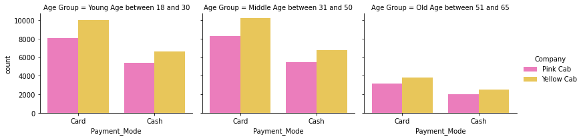
Customer Analysis
Most of the customers choose card to pay the charges of ride in three age groups. However, for the age group from 51
to 65, the difference between two payment mode is negligible by comparison with other two age groups.

Slide 12
Recommendation
Yellow Cab has more advantages than Pink Cab in almost all the aspects
For the profit, Yellow Cab has almost twice more earnings than Pink Cab did in each year, or even in the most of cities.
For the number of customers, Yellow Cab does not have overwhelming advantages, but it still gained 1-3% number of customers more than Pink Cab did in both male and female riders.

Slide 13
Thank You

